Slide 1
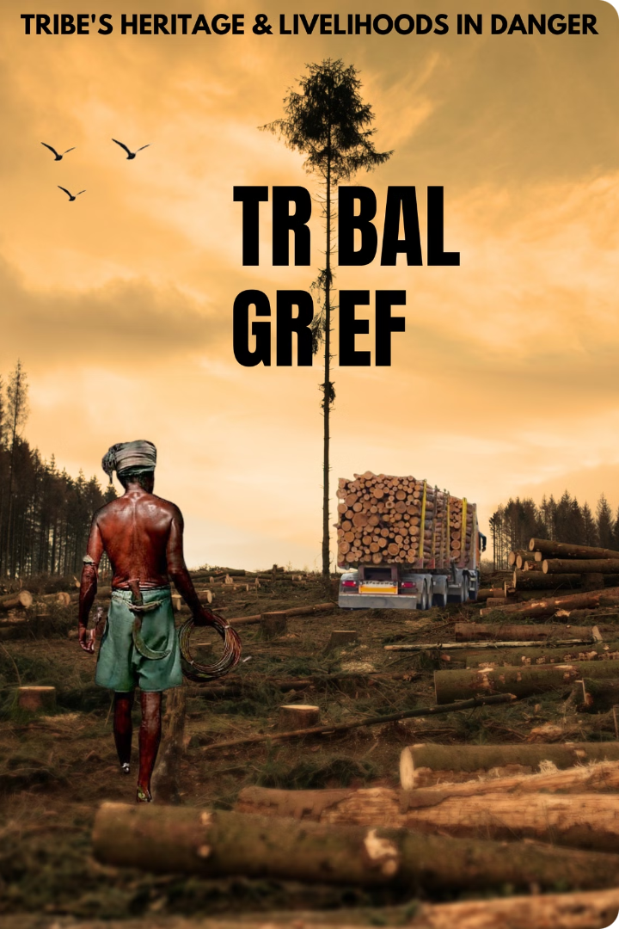
Safeguarding Tribal Rights to Resources and Land
This presentation explores a comprehensive approach to protecting the rights of indigenous communities to their land and resources. It delves into the historical context, current challenges, and innovative solutions that aim to ensure the well-being and self-determination of tribal communities worldwide.

Slide 2
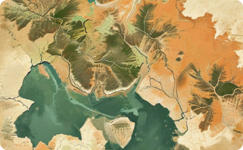



Overview and Core Issues
Indigenous communities face numerous challenges in protecting their land and resource rights. These challenges include displacement due to development projects, exploitation of natural resources without consent, environmental degradation, and a lack of legal recognition and enforcement. This section explores these issues in detail, providing specific examples and statistics to illustrate the severity of the problem.
Displacement
Exploitation
Environmental Degradation
The displacement of indigenous communities from their ancestral lands due to development projects, such as mining, logging, and infrastructure development.
The exploitation of natural resources on tribal lands without the consent or fair compensation of indigenous communities.
The degradation of the environment on tribal lands due to unsustainable practices, leading to loss of biodiversity, water contamination, and climate change impacts.

Slide 3

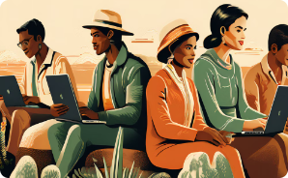
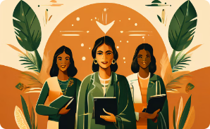

Technological Approaches
Geospatial Mapping
Virtual Reality Experiences
Digital Land Registry
Immutable Records
Utilize GIS and satellite technology to map tribal lands accurately. This can help in documenting land use, detecting encroachments, and supporting legal claims.
Implement a blockchain-based digital land registry to record and verify tribal land ownership. Each piece of land owned by tribal communities will be tokenized as a digital asset on the blockchain.
Blockchain's immutable nature ensures that once land ownership is recorded, it cannot be altered or tampered with, protecting tribal lands from illegal acquisitions.
Develop VR experiences that immerse users in the daily lives of tribal communities, showcasing their connection to the land and the impacts of land dispossession, to raise awareness and empathy.

Slide 4
Technological Approaches
Technology and Education
Resource Depletion Forecasting
Risk Assessment
AI-Powered Legal Assistance
Machine learning models can assess risks related to environmental changes, illegal activities, and natural disasters, helping tribes prepare and mitigate potential threats.
Implement training programs to educate tribal communities on using modern technologies for land monitoring, management, and advocacy. Ensure access to necessary technologies, such as computers, smartphones, and internet connectivity.
Use machine learning algorithms to analyze historical data and predict future resource depletion trends, enabling proactive measures to be taken.
Develop AI-driven platforms that provide tribal communities with legal assistance, helping them understand their rights, draft legal documents, and connect with pro bono lawyers.

Slide 5



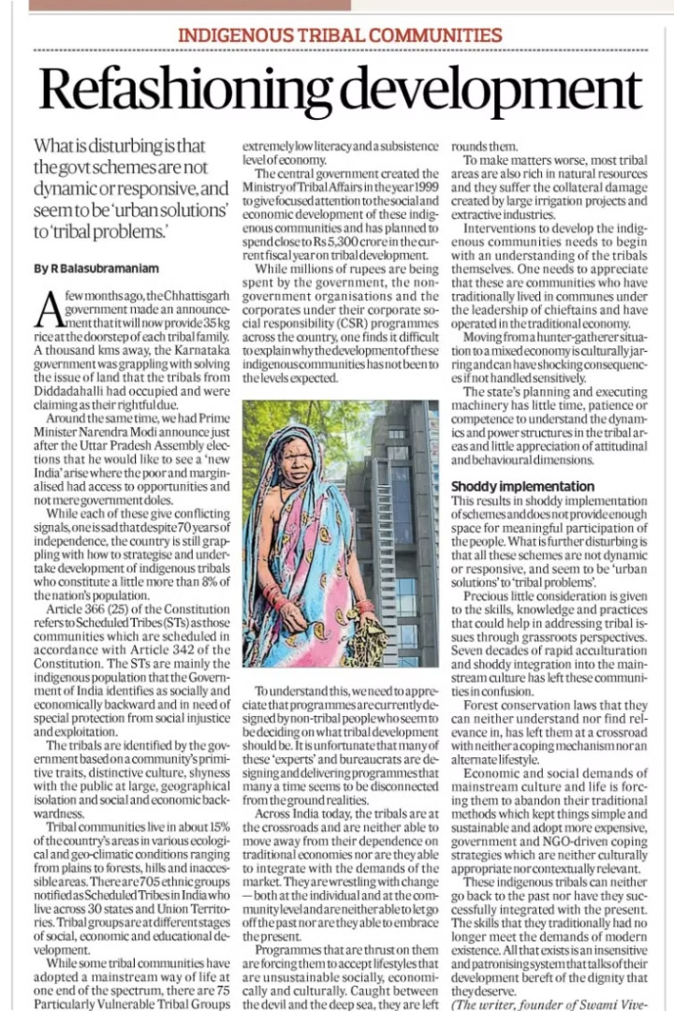

Legal Recognition and Enforcement
Strengthening legal frameworks to recognize and enforce tribal land rights is crucial for protecting indigenous communities. This involves enacting legislation that explicitly acknowledges indigenous land ownership, providing legal support to communities, and seeking international recognition and pressure to uphold these rights. This section explores specific laws and international agreements that support indigenous rights, such as the United Nations Declaration on the Rights of Indigenous Peoples (UNDRIP).
1
Strengthening Legal Frameworks
Enacting legislation that explicitly recognizes indigenous land ownership and provides legal protection for tribal communities.
2
Community Legal Support
Providing legal assistance and representation to indigenous communities to navigate legal processes and protect their rights.
3
International Support
Seeking international recognition and pressure to uphold indigenous rights, including the implementation of international agreements like UNDRIP.

Slide 6
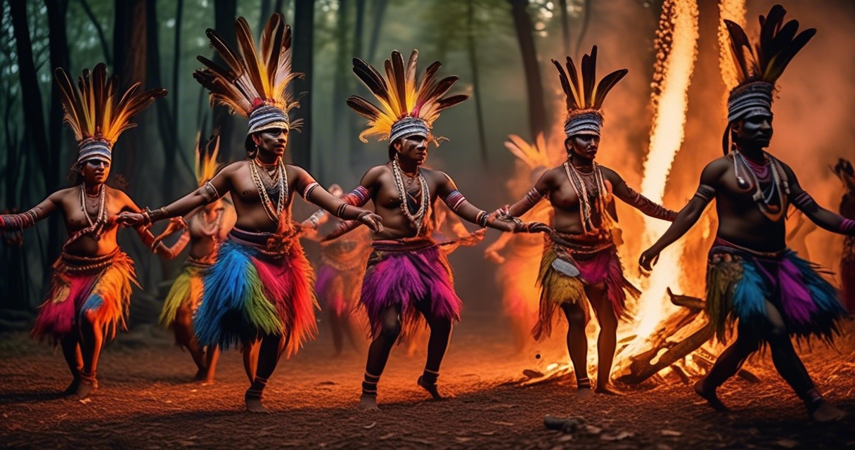
Economic Empowerment
Economic empowerment is crucial for indigenous communities to thrive and maintain their self-determination. This section explores strategies for developing sustainable livelihoods, providing financial support, and ensuring fair compensation for tribal communities.
Sustainable Livelihoods
Developing sustainable livelihoods for tribal communities, such as ecotourism, sustainable forestry, and traditional crafts.
Financial Support
Providing financial support and microloans to tribal entrepreneurs to start and grow businesses.
Fair Compensation
Ensuring fair compensation policies and benefit-sharing mechanisms for indigenous communities when resources are extracted from their lands.

Slide 7
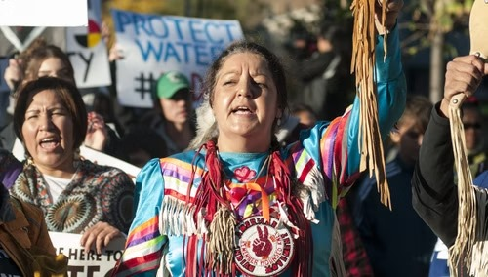
Social and Cultural Preservation
Preserving the social and cultural heritage of indigenous communities is essential for maintaining their identity and resilience. This section explores strategies for documenting and preserving cultural heritage, including indigenous history and culture in education curricula, and improving access to healthcare and education for tribal communities.
Documentation and Preservation
Documenting and preserving cultural heritage through oral histories, traditional arts, and language revitalization programs.
Education
Including indigenous history and culture in education curricula to promote understanding and respect for indigenous knowledge systems.
Healthcare and Education
Improving access to healthcare and education for tribal communities to address health disparities and empower future generations.

Slide 8



Advocacy and Awareness
Raising global awareness about the challenges faced by indigenous communities is crucial for mobilizing support and advocating for their rights. This section explores strategies for engaging the media, partnering with NGOs and corporations, and calling for action to support indigenous rights.
Media Engagement
Partnerships
Call to Action
Engaging the media to raise awareness about the issues faced by indigenous communities and amplify their voices.
Partnering with NGOs and corporations to support indigenous rights and promote sustainable development initiatives.
Calling for action from the audience, suggesting ways they can support advocacy efforts and contribute to safeguarding tribal rights.

Slide 9

THANK YOU !
- Visionary Warriors

